Slide 1
Agile Development
Topic 4:
Roles, Skills and Team Structures
Notes:
NCC Education - Title Master

Slide 2
Topic 4 Coverage
This topic will cover:
  How do teams work?
  Team size and style
  Agile roles and responsibilities
Notes:
NCC Education - Slide Master

Slide 3

Group Exercise - How do Teams Work?
You are now going to be put into groups.
Once in your groups you need to decide on a group name and come up with at least three things that you feel you would need to know to work effectively as a team.
Notes:
Split the class into suitable size groups of mixed knowledge and ability wherever possible. Ask the groups to:
Decide on a group name (this gives a group identity, and encourages members to behave as a group)
Decide what information they need would to know as a group to be effective together when working on a project. You should not prompt the answers, but answers should include:
Clear group objective
Clear timeframe
Knowledge of each other’s skills etc
DSDM ATERN
Modelling
ATERN S2 modelling

Slide 4
Group Exercise - How do Teams Work?
You now need to find out something unique about your group.
Draw a circle and split in into 4 quadrants and label them as shown.
Fill this in as a group to identify things you have in common.
Job
Family
Hobbies
Sport
Can you find something that is unique about your group?
Notes:
They should then:
Try to find out something about their group as a whole which is NOT shared by any of the other groups.
Ideas for the “differences” can be elicited by the following facilitation technique, which involves each group working on producing a ‘group coat of arms’ as follows. Each group should do this separately from the other groups:
Draw a shield or circle and divide into quadrants.
Label the quadrants in turn: JOB (or ‘education background’ if more appropriate); FAMILY; FAVOURITE SPORT; HOBBY.
They should then fill in the quadrants to establish what they have in common.
Each group then looks at what they know about their group (e.g. none have any brothers; they all hate football etc) and identify where they have similarities which may not be shared by the other groups.
Note: They are allowed to ask other groups about their “shields” but should not be prompted to do so. Typically they will NOT take the initiative to ask other groups! Competition and group isolation usually take over. You could point this out AFTER the exercises and presentations are complete: Groups set their own rules, even if those rules are not imposed by management.
DSDM ATERN
Modelling
ATERN S2 modelling

Slide 5
DSDM Agile Teams
  Agile teams are:
    Self-directed
    Small
    Composed of users and developers with equal responsibility
    Subject to re-structuring if team is not working
    Underpinned by a team success approach/no blame culture
Notes:
Traditional life cycles such as the Waterfall Model require a very tightly managed team, whereas the Agile teams are far more self-directed.
The initial team will involve key members from management. This is where the foundations will be structured. From here the teams will be smaller, and may concentrate on either a small part of the project or the same team may just work on a small incremental part of the project, before moving on to the next stage.
There will be minimal management involvement and the team will work to the defined requirements all with a shared goal.
Everyone is equal.
If the teams are not working effectively then re-structuring is implemented.
An open, honest working team that will work together to solve issues and avoid blame. Acting together by means of mutual respect.

Slide 6
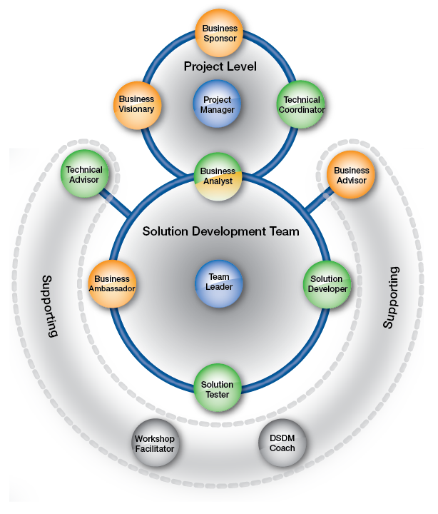
Team Roles and Responsibilities
Project team:
Project Manager
Business Sponsor
Technical Co-Ordinator
Business Visionary
Team Leader
Solution Development Team:
Business Ambassador
Solution Developer
Business Analyst
Solution Tester
External Support:
Business Advisor
Workshop Facilitator
Source: Image from dsdm.org © 2016
Notes:
There is no set team member requirements for an Agile project, but there are some common roles. These roles would almost certainly apply in a large project, but could be condenced for a smaller project.
Common roles include:
Project team:
Project Manager
Business Sponsor
Technical Co-Ordinator
Business Visionary
Team Leader
Solution Development Team:
Business Ambassador
Solution Developer
Business Analyst
Solution Tester
External Support:
Business Advisor
Workshop Facilitator

Slide 7


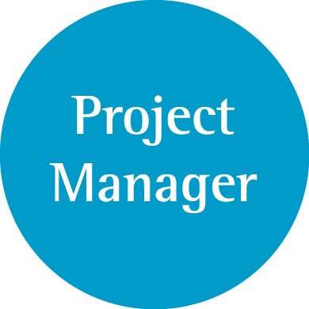

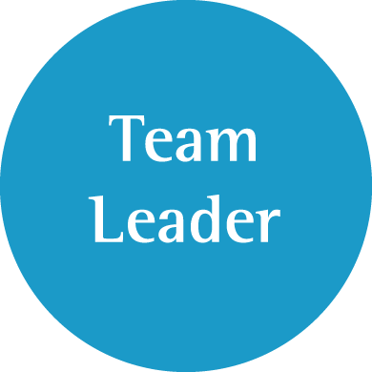
Project-level Roles
Source: Image from dsdm.org © 2016
Notes:
DSDM ATERN
Roles, Skills and Team Structures
ATERN S3 roles skills
(C) DSDM Consortium 2007
The project team will not be involved throughout the whole project process, but are key at the beginning of a project to set and define the project plan, requirements and outcomes.

Slide 8





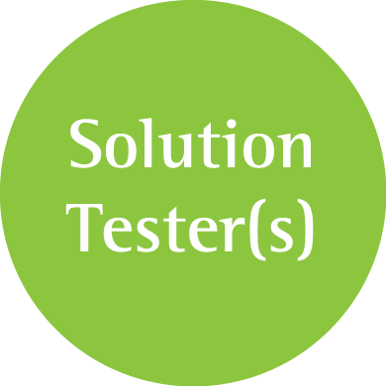

Solution Development Team Roles
Source: Image from dsdm.org © 2016
Notes:
The Solution Development Team are responsible for a large proportion of the project. They will all have their set tasks, but will need to work together and co-ordinate work between each other.
Occasionally it may be necessary to bring in external support such as Business Advisors or Subject Matter Experts (SME’s) and Workshop Facilitators or perhaps even Agile Development Coaches/Advisors.

Slide 9
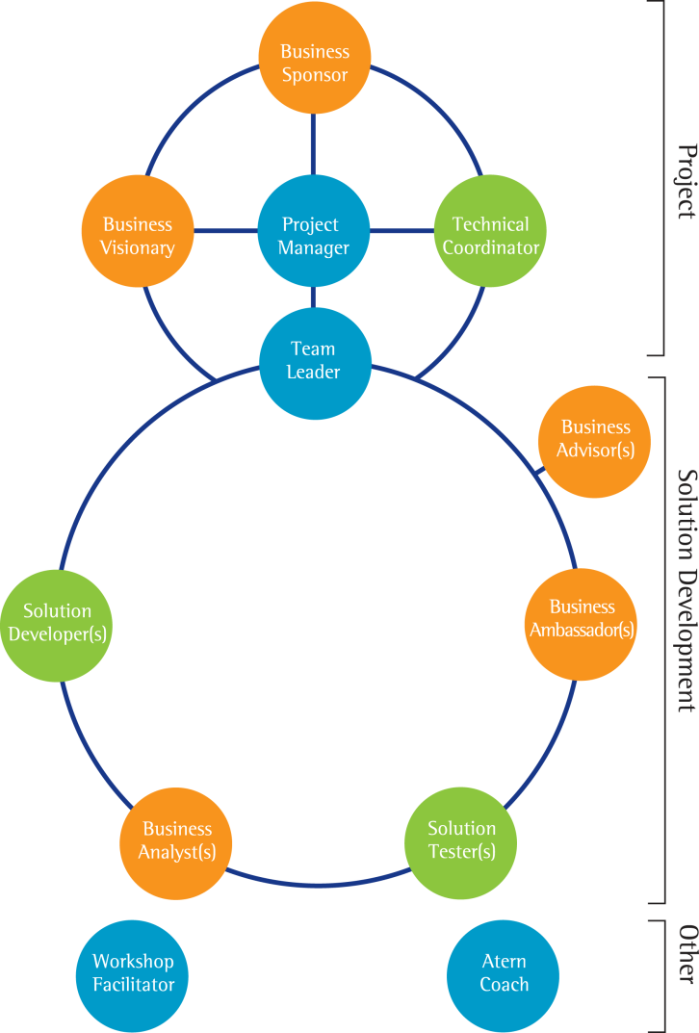

Multiple Teams
There may even be multiple smaller teams within the main Solution Development team.
Source: Image from dsdm.org © 2016
Notes:
There may even be multiple smaller teams within the main Solution Development team. Each team will have a set small part of the main project to work on, that will eventually feed back in to the main project.

Slide 10
Specialist Roles – 1
  Specialists may be brought in as required, including but not restricted to:
    Business consultants
    Technical consultants
    Specialist in human factors
    Configuration manager
    Quality manager
Notes:
Depending on the project and the skills the team have, there may be the need to bring in specialists to support a project. The list is exhaustive, as it will be bespoke needs that need to be met. They may play a role in a very small part of the project, or they could form a major part of the project team or solution development team. Their skills will be invaluable to ensuring success.

Slide 11
Specialist Roles – 2
    Systems integrator
    Operations co-ordinator
    Support and maintenance specialists

Slide 12
Summary of Roles, Skills and Responsibilities – 1
  How do teams work?
    Self-directed
    As equals
    With communication
Notes:
The Agile method should allow for all participants to be equals; they should be able to work collaboratively in a self-directed manner to reach the agreed goals.
The size and style will be flexible and should meet the individual project needs.
There are some common roles and responsibilities, but this is flexible overall as long as the key elements can be managed. A project could just include a Project Manager, Technical Co-Ordinator, Solution Developer, Business Analyst and a Solution Tester or all the entities highlogted on the slide.

Slide 13
Summary of Roles, Skills and Responsibilities – 2
  Team size and style
    Will vary from project to project
    Likely to work in small teams feeding into the overall project

Slide 14
Summary of Roles, Skills and Responsibilities – 3
  Agile roles and responsibilities:
    Project Manager
    Business Sponsor
    Technical Co-Ordinator
    Business Visionary
    Team Leader
    Business Ambassador

Slide 15
Summary of Roles, Skills and Responsibilities – 4
  Solution Developer
  Business Analyst
  Solution Tester

Slide 16
Topic 4 – Roles, Skills and Team Structures
Any Questions?
Notes:
NCC Education - End Slide Master

